Slide 1
What are you doing?
Present Continuous Tense

Slide 2
What is present continuous tense?
The present continuous is also called present progressive.
The present continuous verb tense indicates that an action or condition is happening now, frequently, and may continue into the future.

Slide 3
Usage of Present Continuous Tense
Used to express a habit that is still ongoing. Example: Mr. Leo is teaching Japanese this semester.
Used to describe an action that is happening now but it doesn’t mean happening when we speak. Example: What are they doing right now? They are reading a book right now.
Used to tell and ask what going on/happening/doing is by someone at the moment we are talking. Example: Is Dewi writing a letter at the moment? Yes, she is. / No, she isn’t.

Slide 4
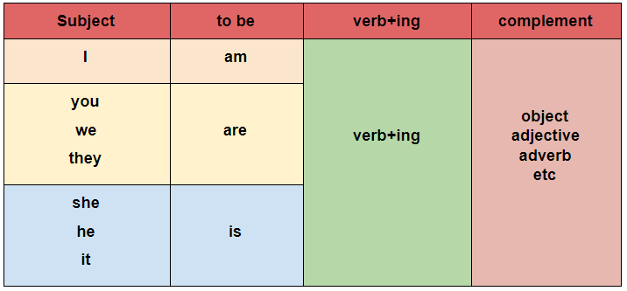
Positive Pattern

Slide 5
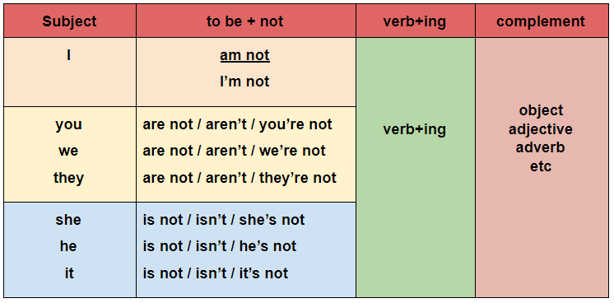
Negative Pattern

Slide 6
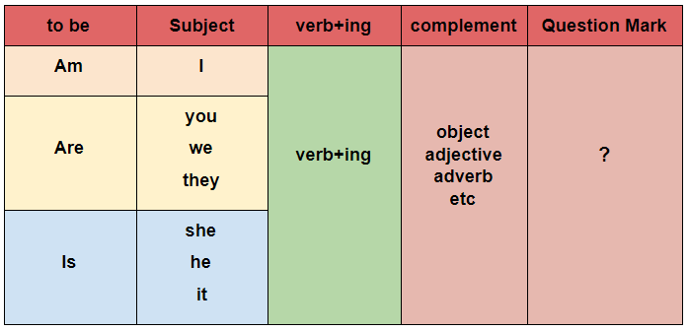
Interrogative Pattern

Slide 7
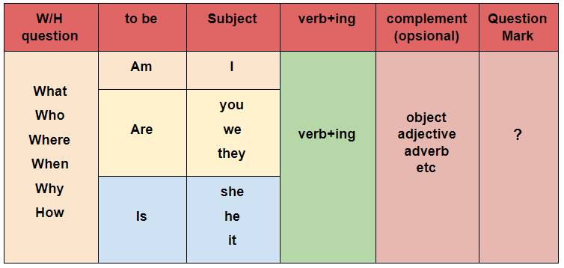
WH Question Pattern

Slide 8
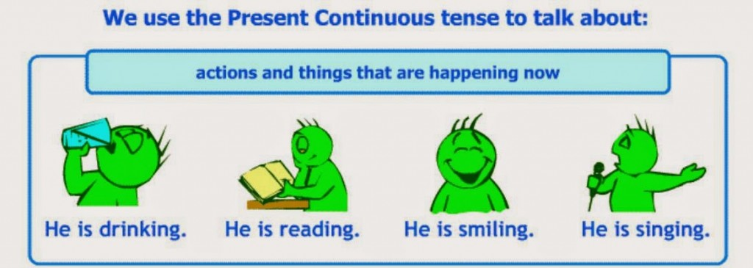

Slide 9
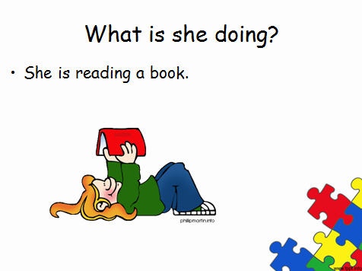

Slide 10
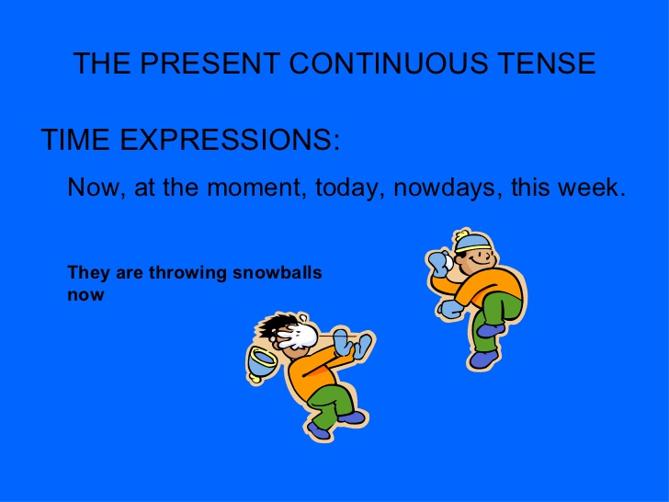

Slide 11
Sentences
+ She is writing a letter.
- She isn’t writing a letter.
? Is she writing a letter?
2. + The cat is playing with the ball.
- It is not playing with the ball.
? Is the cat playing with the ball?
3. + Rudy is calling me.
- Rudy isn’t calling me.
? Is Rudy calling you?

Slide 12
Choose the correct answer!
Luki: What is Priyo doing in his vacation now? Lusi: He is … to Bangladesh now. a) go b) went c) gone d) going
Desta: What is your sister doing with her friends in the library? Pras: They are … a) buying some books b) lending some books c) borrowing some books d) collecting some books
I … to help her, if I have time. a) am going b) go c) goes d) went
4. … you … when I visited your house yesterday? a) were sleeping b) are sleeping c) did sleeping d) were sleep
5. Olla: Where is Mommy, Daddy? Father: She is in the living room. She … movie on TV. a) watched b) watches c) is watching d) will watch

Slide 13
Change into Present Continuous sentence!
1. I take two breads for my breakfast. 2. They watch Kahitna’s concert in Jakarta. 3. Dendi does his homework at home. 4. Laila plays computer game with her friends. 5. Bubu sings Ariana Grande’s songs in her friend’s birthday party.

